Slide 1
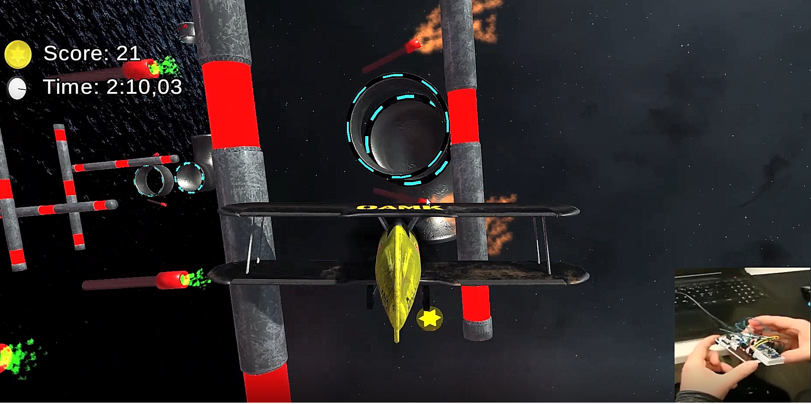
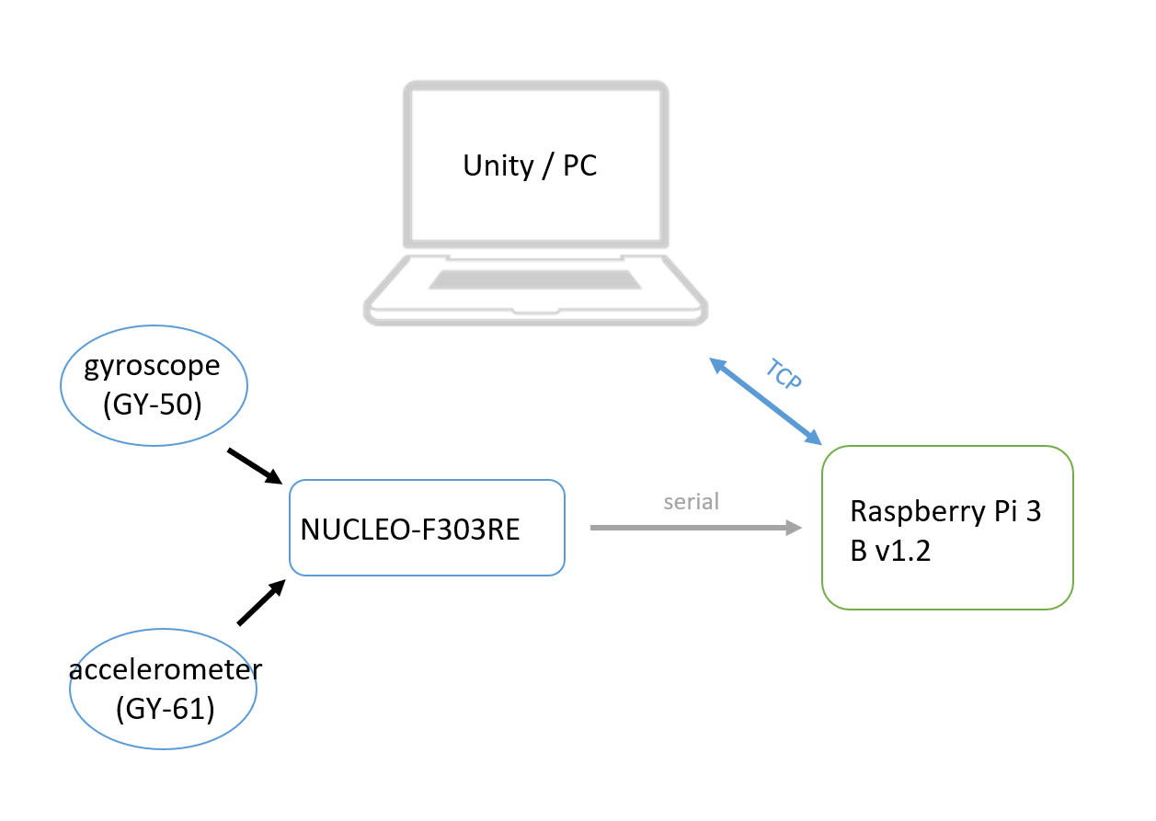
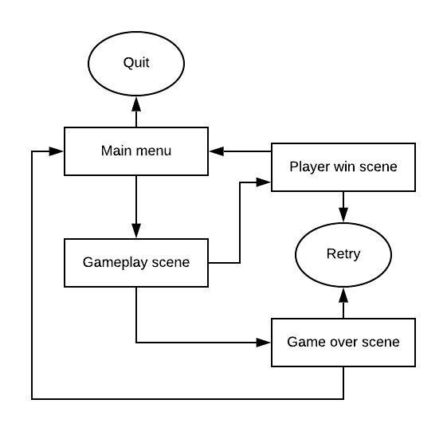
Sensor-controlled Unity flight game
Roope Kettunen, Jesper Ruuska, Tapani Silvola TVT18SPO
Information Technology, Software Development
Introduction
The aim of this project was to develop a 3D flight game in Unity with a custom-built sensor controller using embedded systems technology. The gameplay consists of flying an airplane while collecting coins and clearing an obstacle course.
Objectives
The primary objectives were as follows: to calculate angular data with a Nucleo microcontroller, send said data through Raspberry Pi (as per requirement) to Unity and to use the data to control the airplane’s rotation in-game.
Additionally a working game would need to be created, complete with custom graphical assets, sound and level design.
FIGURE 1. Data flow and connections
Methods
The controller prototype was built using an accelerometer (GY-61) and a gyroscope (GY-50) coupled with a Nucleo-F303RE microcontroller. The processed and filtered data from these sensors provide the pitch and roll of the controller accurately.
The Nucleo sends the angular data to Raspberry Pi 3 B v1.2 over a serial connection. The RasPi is connected to a PC via cabled LAN. RasPi runs a Python program that creates a TCP socket connection to Unity (running on the PC), relaying the angular data to the game. The game then uses this data to adjust the airplane’s pitch and roll directions and speeds.
Various C# scripts were created for the game, including ones related to controlling the plane, flying through checkpoints, collecting coins, handling collisions and switching scenes.
The game’s graphical assets were created with Blender 3D, Substance Painter and Photoshop.
FIGURE 2. Game state flowchart.
Results
A magnetometer (GY-271) was tested for measuring the yaw of the controller, but due to magnetic interferences the data proved too unreliable and thus unusable.
Apart from the missing yaw rotation, the controller worked splendidly. It was very accurate and responsive and the angular data did not drift even over extended periods of time.
The game physics had to be streamlined to a more non-realistic approach in order to favor controllability and overall gameplay experience. The game itself was fully completed and playable with many additional features.
PICTURE 1. Gameplay with the prototype controller.
Conclusions
The project team learned a lot about Unity game development using version control (GIT) and Agile project management methods.
References
https://os.mbed.com/platforms/ST-Nucleo-F303RE/
https://www.raspberrypi.org/products/raspberry-pi-3-model-b/
https://unity.com/
Embedded Systems Application Project
ECTS credits: 6
Date of publication: 2019, Winter
Instructors: Lasse Haverinen, Timo Vainio

